Slide 1
Animal Friends In Need
Aijha Reed, Sally Anderson, Kyle Novak, Kenia O. Berrios
Notes:
Kyle

Slide 2
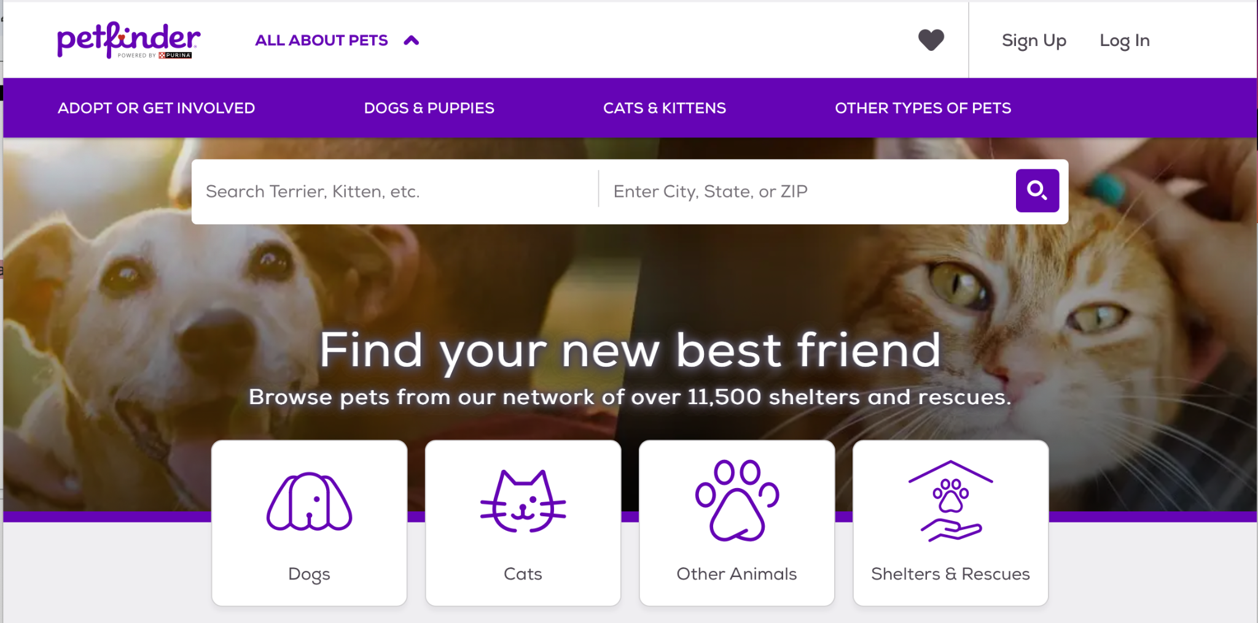
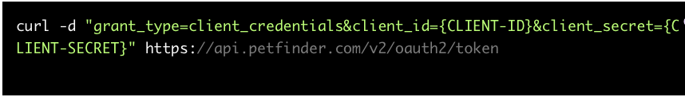
Petfinder API
Pets of all kinds
Dogs
Cats
Rabbits
Chickens…
API Considerations
Shelter Animal Counts
Rescue Groups.org
Notes:
Kyle

Slide 3
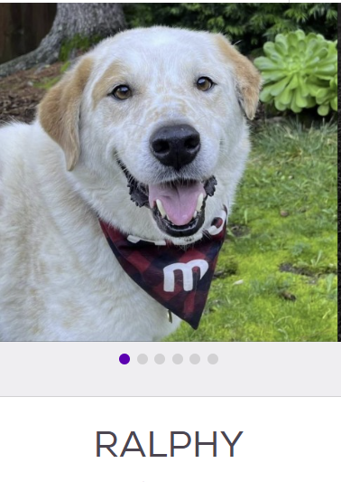
Limitations
Extremely large dataset
14,000 pages worth of data
We reduced that down to ~300 pages with 1,900 animals
Wide range of outliers
West Coast states were originally picked to to be analyzed due to influx of api data
Hawaii and Alaska only had 20-30 adoptable pets compared to the thousands in the other west coast states, therefore not giving the visual representation we originally wanted
Duplications- due to fostering
Notes:
Upon pulling our API we immediately came across some limitations. We discovered that the api had 14,000 pages and over 200,000 pets at random. Therefore we decided that for the first release of our app the user would be able to locate pets within just the west coast states. However, some major outliers arouse in the states of Alaska and Hawaii. When we filtered through the entire api Hawaii and Alaska only held about 20-30 pets per state. That’s when we decided that the user should be able to adopt based on where there is the most need. Our app allows the user to filter a pet feature and see a visualization to reflect what areas are oversaturated. To expand on our limitations, we also stumbled on pets that were fostered, causing duplicate pet entries in our database.

Slide 4
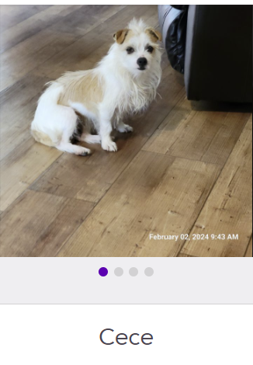
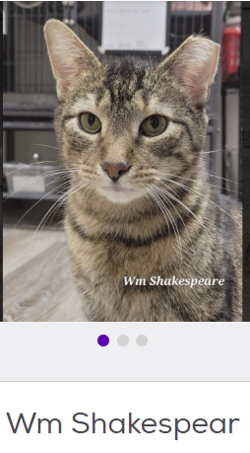
Ethical Considerations
Protect personal information:
Individual contact information like phone numbers, emails, and home addresses
Notes:
Ethical Considerations need to be taken very seriously, for the development of our app our api originally presented with personal contact information, which displayed personal phone numbers and emails. therefore we decided to remove the contact information from our database and only keep the URL that reflects the organizations name as a way for the user to contact the organization directly.

Slide 5
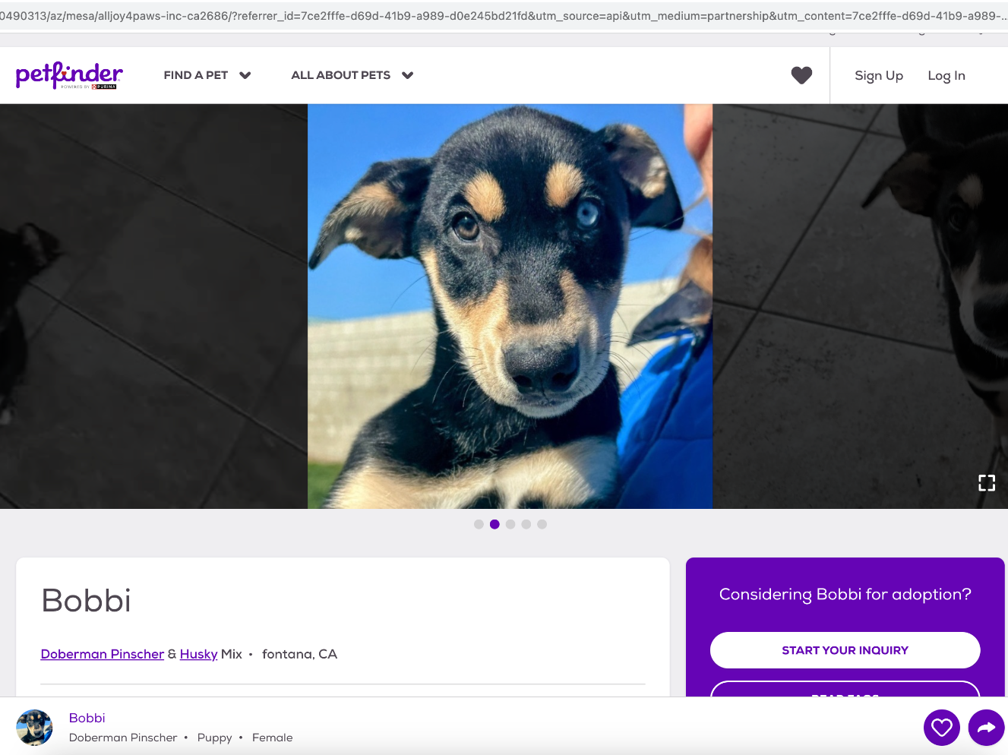
ETL Process
Once the data we needed was clear we:
Dropped duplicates- to eliminate the fostered pets showing up twice
Dropped NA
Dropped contact Information
Retrieved the state where each pet was located and created a state column
Bobbi is currently a fostered pet awaiting her forever home near you!
Notes:
Kenia- In our ETL process we considered what data we needed to keep, so that our user achieves the most interaction in different filtration categories, therefore when cleaning the data we dropped duplicate pets that came from fostering entries, dropped null values, dropped the personal contact information, and retrieved the state out of each organization_id to allow the user to filter in our app by state.

Slide 6
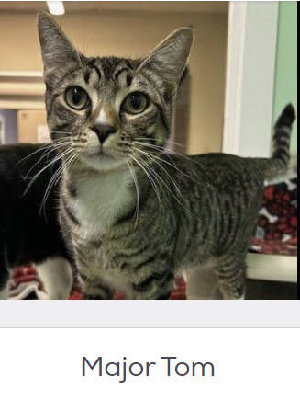
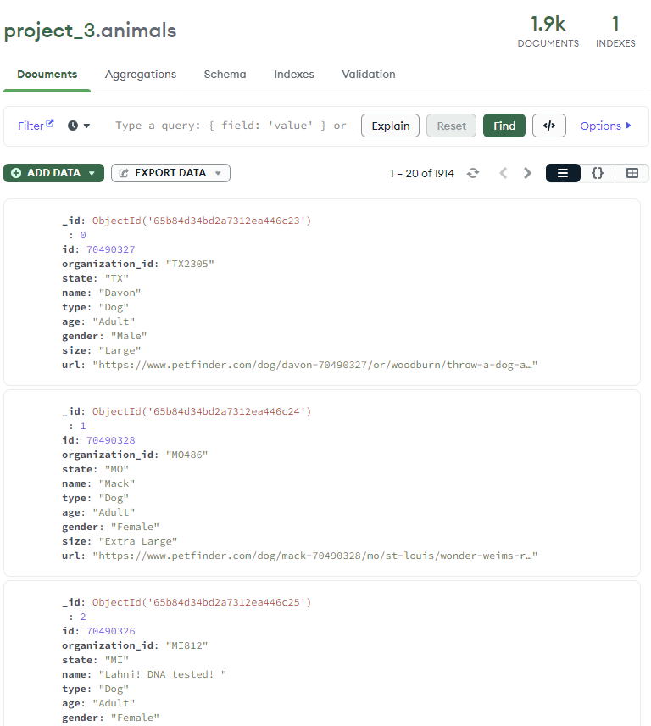
MongoDB NoSQL
Database
MongoDB is a NoSQL database that is used with Pymongo module to retrieve your data.
MongoDB Process:
Create Database- project_3
Create Collection- animals
Import cleaned CSV
Confirm the amount of documents imported to ensure no data is lost
Confirm # of documents
Notes:
Kenia- MongoDB is the database we chose to store our collection in due to the fast connection and nature of pymongo. This allowed us to store our database locally and connect our api routes. For this process we created our database, created the collection, imported our cleaned csv from the ETL process and most importantly, confirmed that we did not lose any data so that the user can maximize and explore the numerous amount of pets in our database.

Slide 7
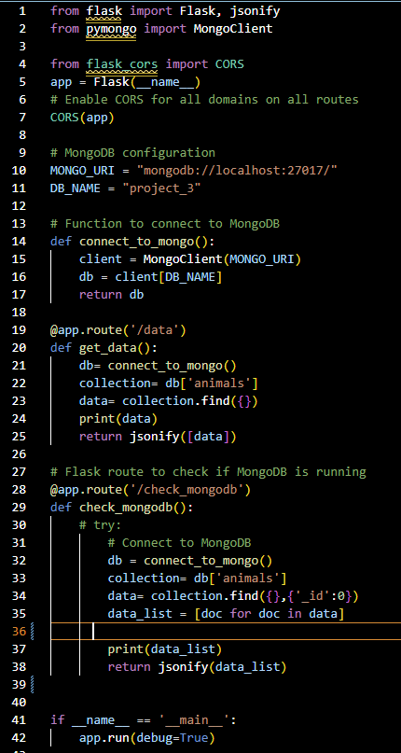
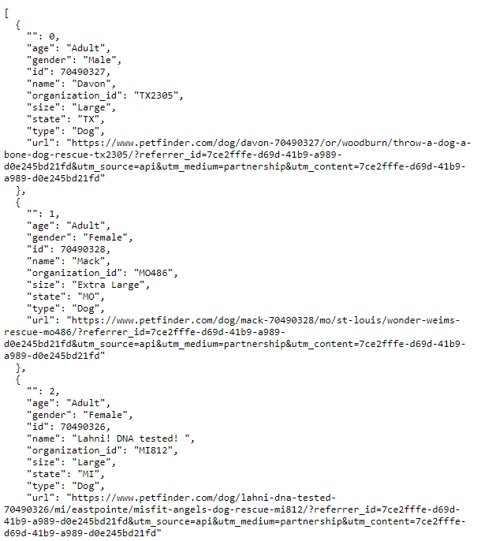
Flask and PyMongo
Import Pymongo to read MongoDB database
Called localhost from MongoDB and selected database names with variables
Connected to MongoDB using MongoClient()
Created Flask @app.route(‘/check_mongodb’) that displays our jsonified data on the localhost development page
Runs without error
Screenshot of localhost webpage
Notes:
Sally- After making the database, we needed a way to render the database on a local server. To do that, we created a back-end Flask App. We used Pymongo to call the database using MongoClient() function. Our route to the database was called ‘/check_mongodb’. On the left is our Flask App code and on the right is a screenshot of the render jsonified data in the local server.

Slide 8
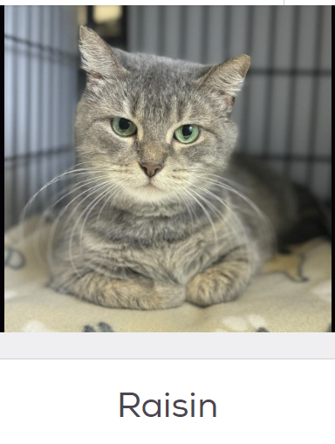
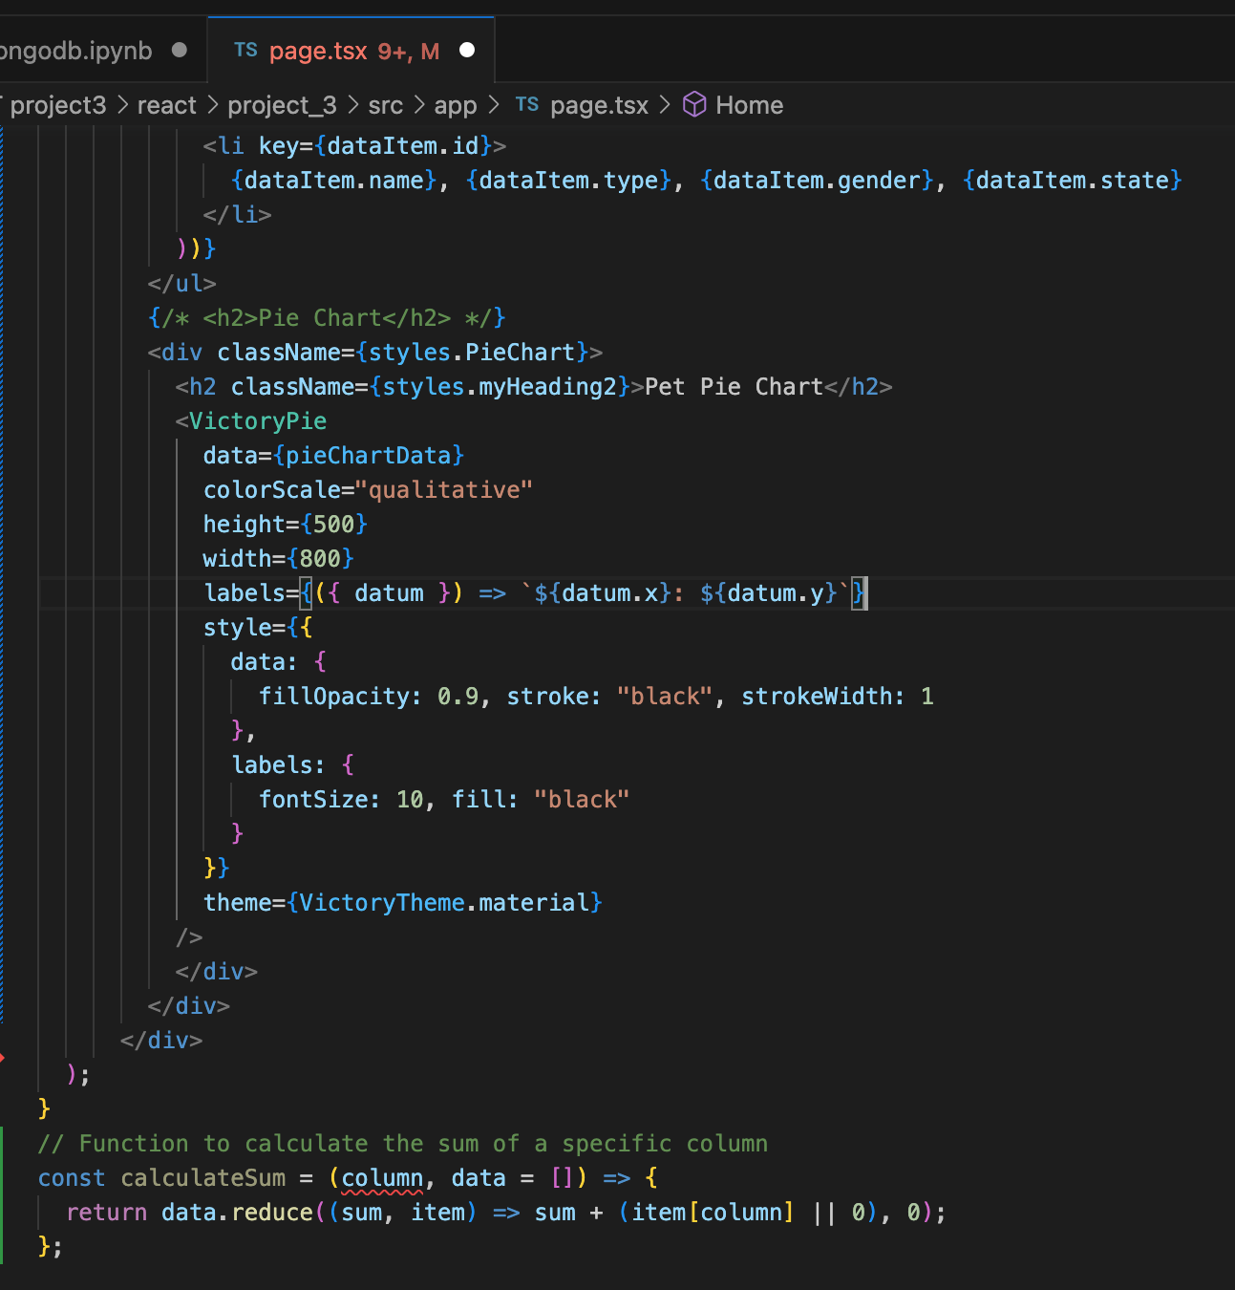
React.js
Javascript Axios to make HTTP request from our Flask localhost to get our jsonified data
React.js Victory to chart user-selected data
Process:
Function to handle column change
Function to handle value change
Function to filter data, reflecting the column and value change
Styling website, reflecting list of animals
Pie charts that reflect user-interaction with dropdown selection
Notes:
Sally - To create our user-interface, we chose to use React.js, which is a front-end Javascript library for building user interfaces bose on components. To read our back-end server, we used Axios. To create our charts, we used Victory. On the right you’ll see the code for our Victory pie charts. To render the pie charts, we made components to handle column change, value change, filter data to reflect column and value, change in filtered listing of animals, all of which are controlled by the user-selected dropdown.

Slide 9
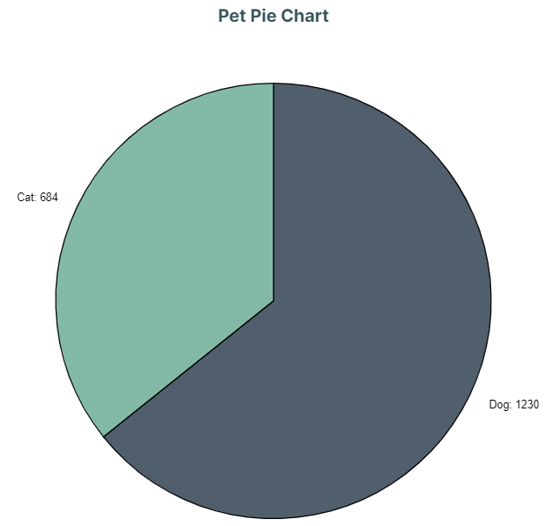
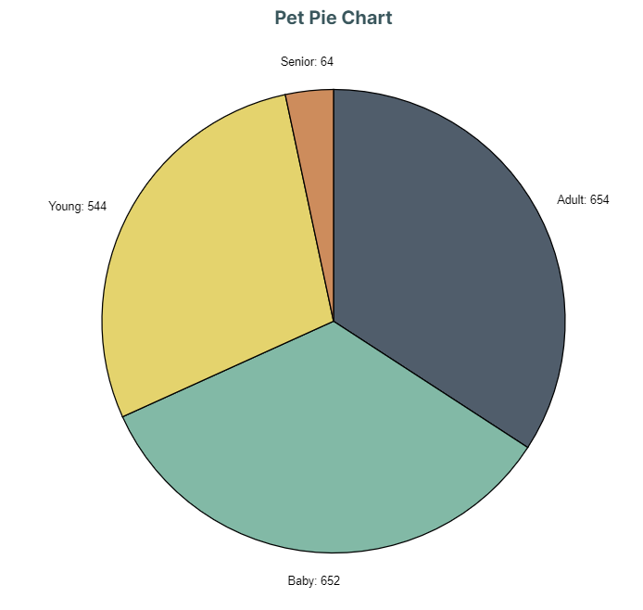
PET TYPES
PET AGES
Notes:
Sally - To give a preview of our data selected charts, here is the pie charts for pet types and pet ages.

Slide 10
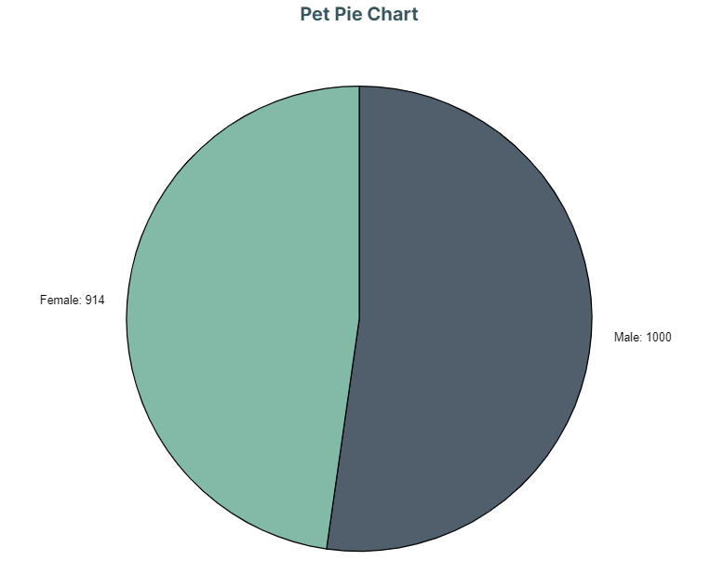
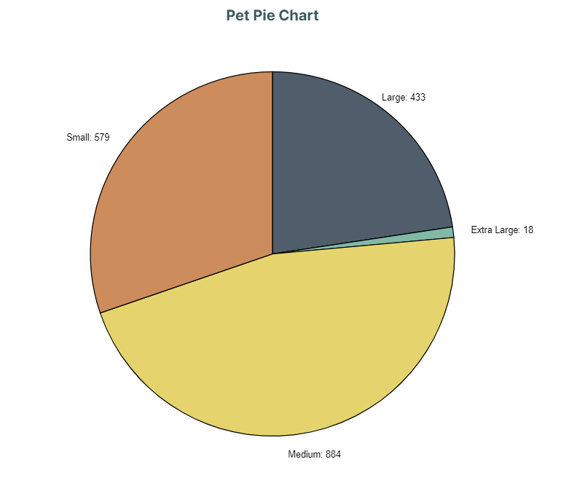
PET GENDERS
PET SIZES
Notes:
Sally - here is the pie charts for pet genders and pet sizes

Slide 11
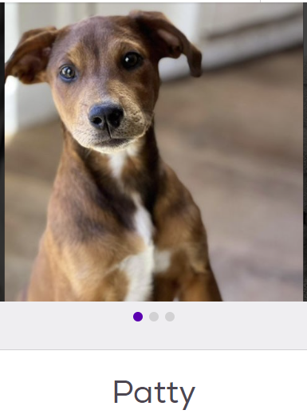
Our Work-Flow
Flask App
React.js
Petfinder.com API
Renders json dictionary in local-host
server
Load Raw Data
Renders data list, selector dropdown buttons, and pie charts
MongoDB
Reads database using Pymongo
ETL
Export Cleaned data in .csv file
Website
Notes:
This slide is a recap our our entire work-flow. We get the data, clean the data, created a database, called the database, rendered the jsonified data in back-end localhost, called the back-end host by creating user-interface that selects for particular column/values that renders lists and piecharts.

Slide 12
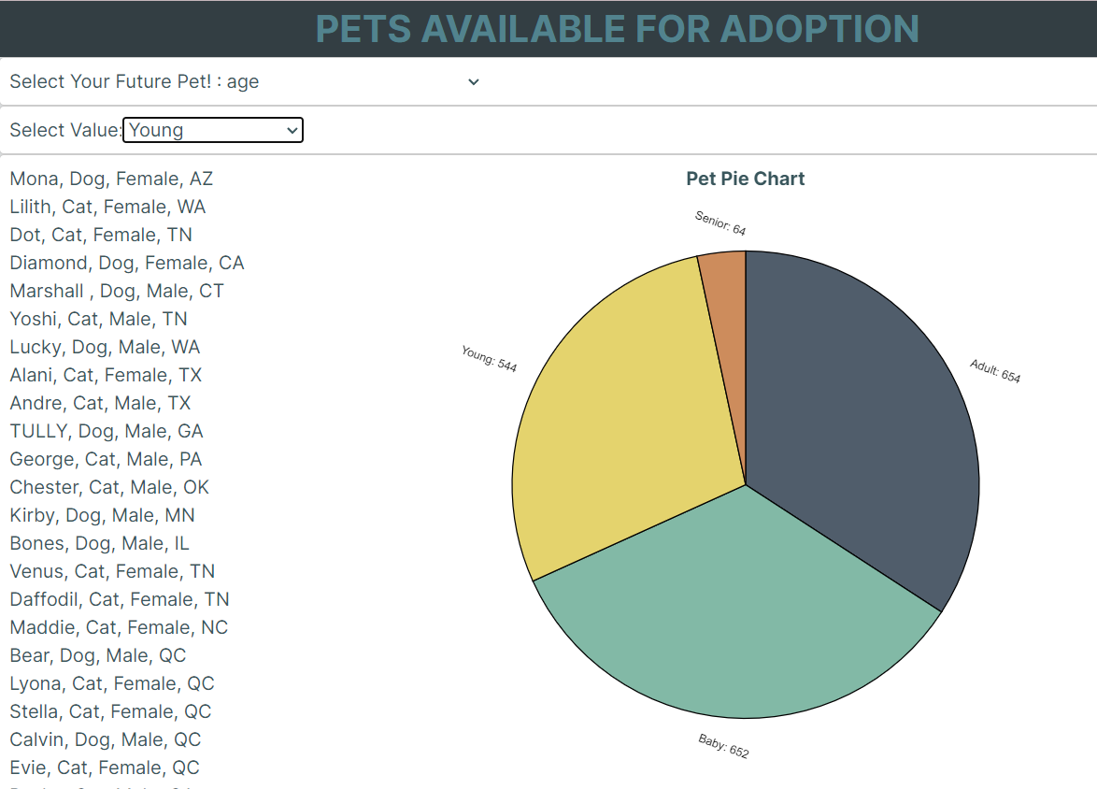
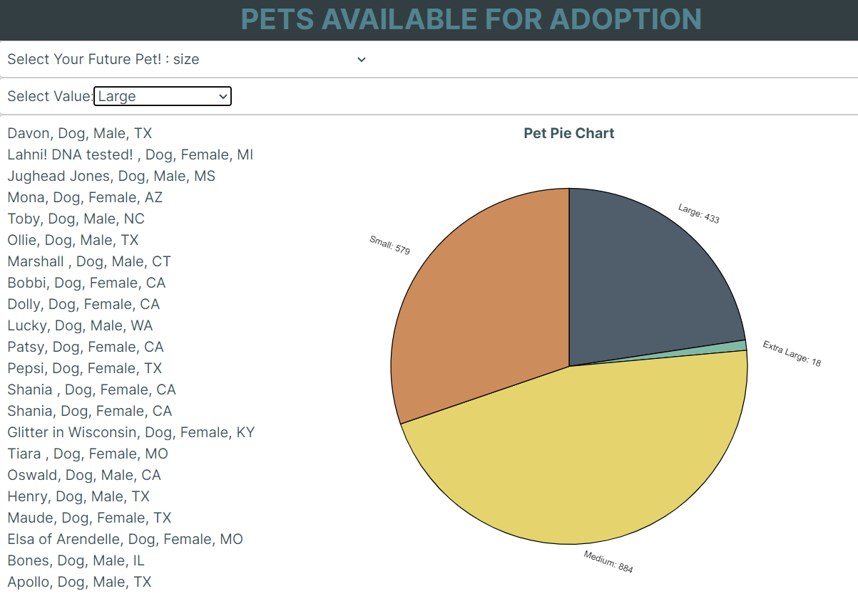
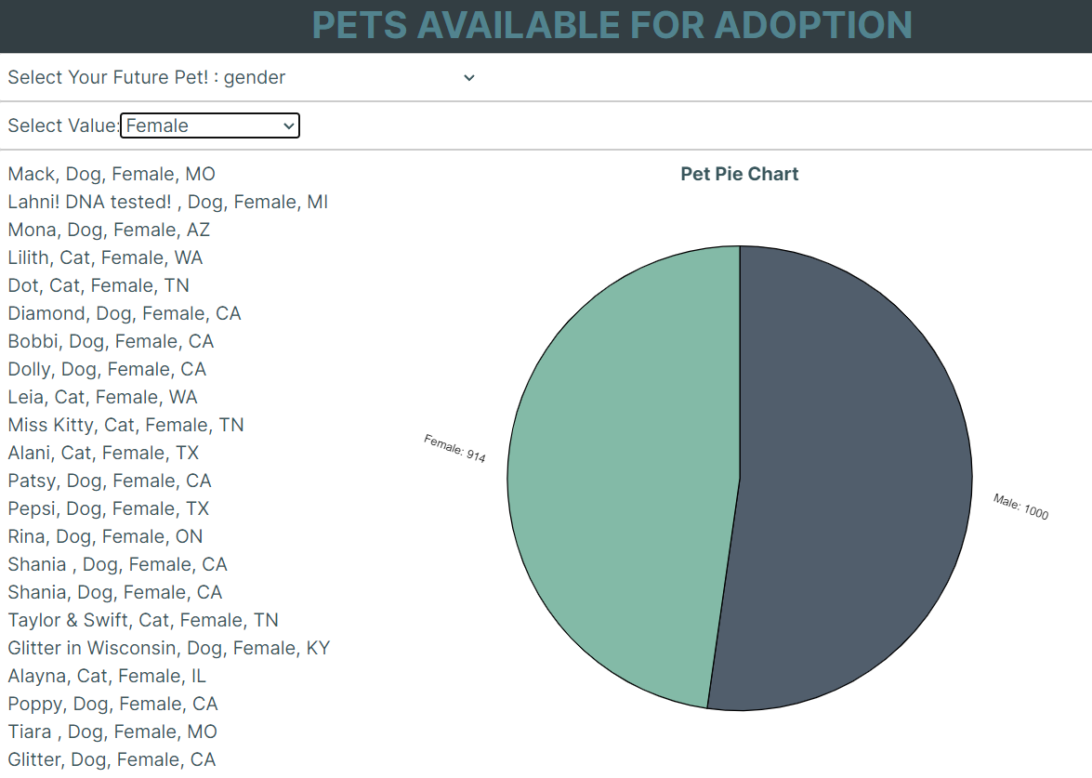
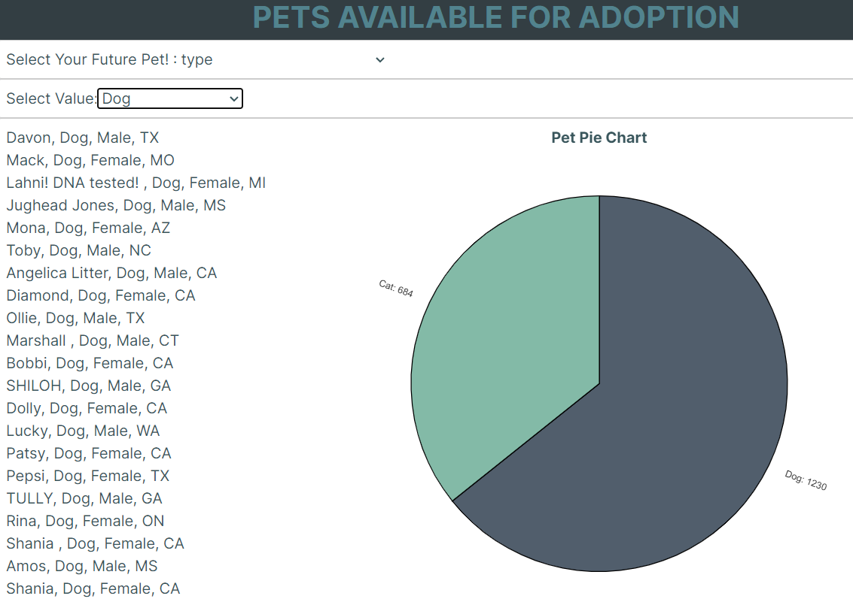
Demo
Notes:
Aijha

Slide 13
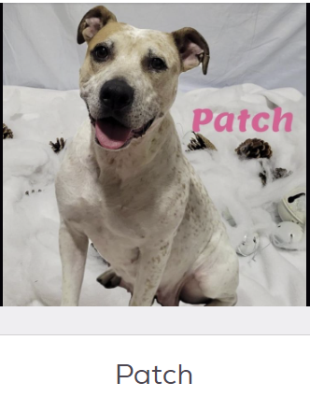
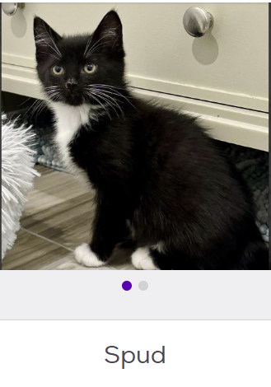
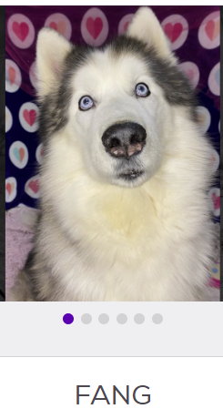

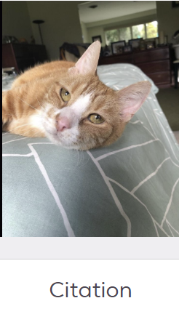
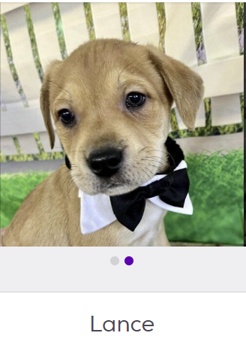
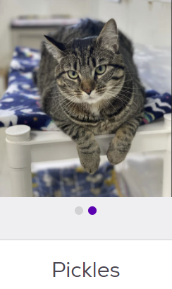
Future Works and conclusion
Our website allows you to enhance your pet adoption process by way of visualization.
Adopt the animal in the most need of adoption.
Future work:
Embed a direct link to the animal selected
Add extended dropdown sub-categories
Coding to be adaptable for the visualizations to look smoothly on different devices
Notes:
Aijha
--add national sub categories to narrow choice

Slide 14
References
https://www.petfinder.com/developers/v2/docs/
https://www.shelteranimalscount.org/data-request-individuals/
https://rescuegroups.org/
Jared’s help
https://www.washingtonpost.com/business/2022/01/07/covid-dogs-return-to-work/
https://www.petfinder.com/privacy-policy/en/
Chat-GPT 3.5
Victory Chart
https://analyticsindiamag.com/step-by-step-guide-to-data-analysis-using-sweetviz/

